Slide 1

Emotion & Gender Recognition using Tensorflow
END-Of-Studies Project
Business Intelligence & Data Science
Supervised by
Dr.BENKIRANE Said
Realized by
OUGOUAMMOU Soukaina
BAMOULA Abdelghafour
University year 2021 / 2022

Slide 2

01
02
Table of Contents
03
04
Problem definition
Dataset &Algorithm used
Tools
Implimentation
05
Conclusion

Slide 3
Subject Introduction

Slide 4
Work Process
Implementation of the CNN algorithm
Enviroment descovery
Phase 1
Phase 2
Phase 3
Phase 4
Data collection
&
preprocessing
Build the application interfaces

Slide 5
Problem definition
CNN
models
predictions
reshape
Image
Emotion prediction
Gender prediction

Slide 6
Emotion & gender recognition problem
Face detection
Detect the emotion and the gender
Visualize the prediction in a real time application

Slide 7
Our Solutions
Face detection
emotions and gender
Classification
01
02
For this problem we used openCV to detect the faces
For this we will use the CNN algorithm to classify an input images into one of the7th classe also as the gender
Real time application
03
For this we programed interfaces using to predict the emotion in real time

Slide 8
Dataset Description

Slide 9
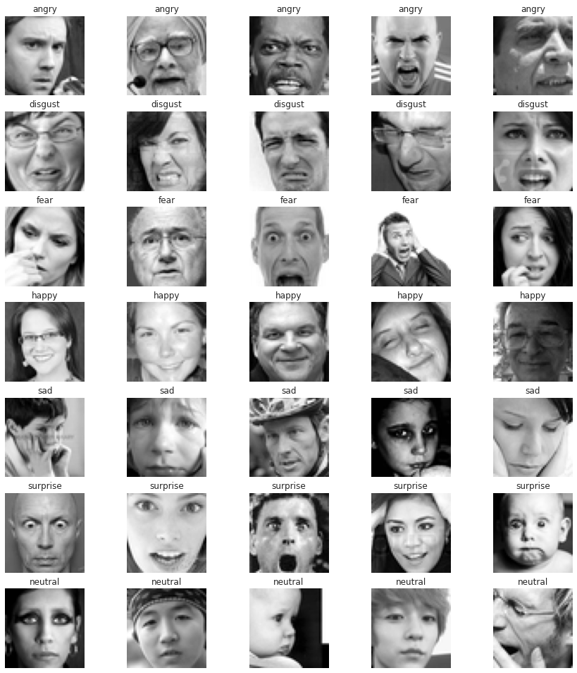
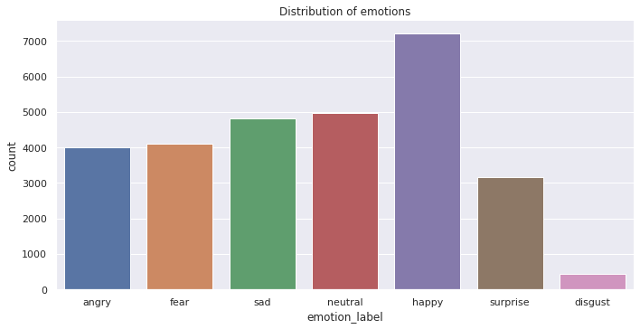
Datasets used
We used the FER-2013 dataset that contain grayscale images to train the CNN model

Slide 10
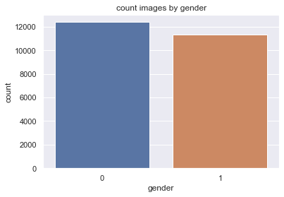
Datasets used
For gender recognition we used The UTK-Face dataset, that contain grayscale images for gender recognition

Slide 11
Algorithms Used

Slide 12
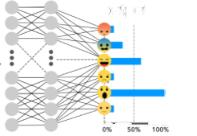
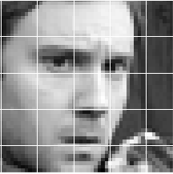
CNN algorithm
2nd sequential convolutional layer 32 filters
4 sequential convolutional layer 128 filters
2 Dense layers with a 20% dropout
1st sequential convolutional layer 16 filters
3 sequential convolutional layer 64 filters
Grayscale 48x48 image
Max pooling 2x2
Max pooling 2x2
Max pooling 2x2
Max pooling 2x2

Slide 13
Conv2D
Notes:
The 2D convolution is a fairly simple operation at heart: you start with a kernel, which is simply a small matrix of weights. This kernel “slides” over the 2D input data, performing an elementwise multiplication with the part of the input it is currently on, and then summing up the results into a single output pixel . This applied for features extraction

Slide 14
Max Pooling
Notes:
Max Pooling is a pooling operation that calculates the maximum value for patches of a feature map, and uses it to create a downsampled (pooled) feature map. It is usually used after a convolutional layer.is used to reduce matrix dimension

Slide 15
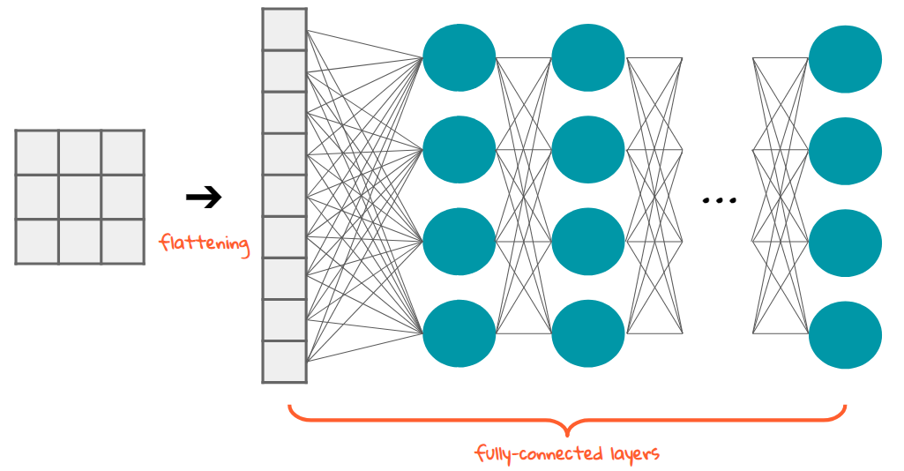
Flatten & fully-connected
Notes:
Flattening is converting the data into a 1-dimensional array for inputting it to the next layer. We flatten the output of the convolutional layers to create a single long feature vector. And it is connected to the final classification model, which is called a fully-connected layer. In other words, we put all the pixel data in one line and make connections with the final layer.

Slide 16
Tools

Slide 17





Programming tools
Python
Tensorflow
Keras
openCV
PyQt

Slide 18




Development Environment
Collab & jupyter notebook
Spyder & VScode

Slide 19
Implementation

Slide 20
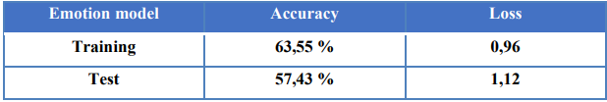
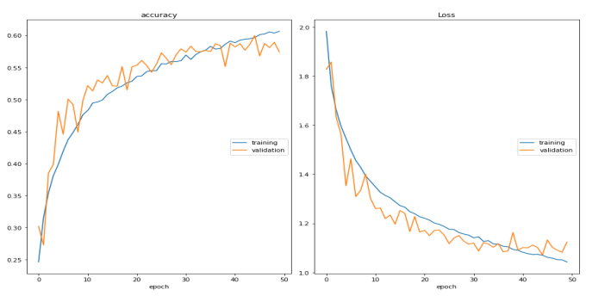
Evaluation metrics

Slide 21
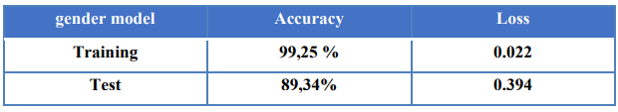
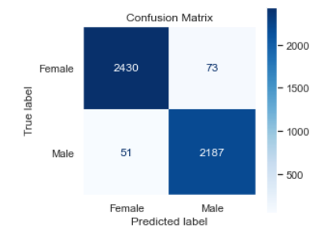

Slide 22
Conclusion

Slide 23
Thanks for your attention

